Slide 1
Weekend activities
Basic 3 unit 7b

Slide 2
go to school

Slide 3
do homework

Slide 4
sleep

Slide 5
go for a walk

Slide 6
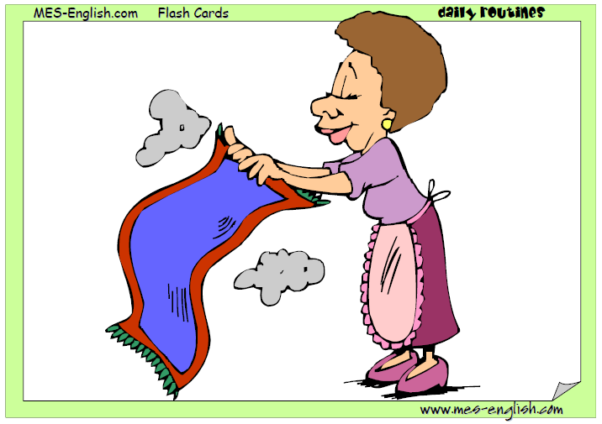
clean the house

Slide 7
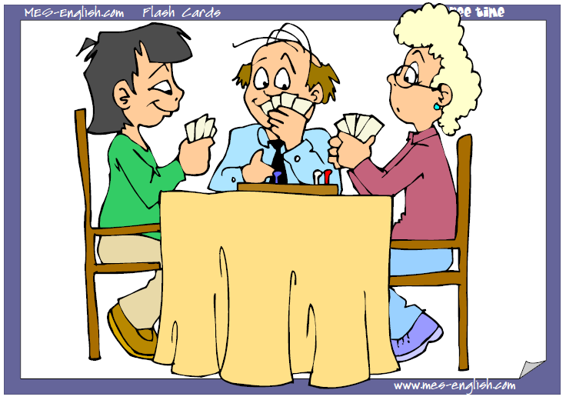
play cards

Slide 8
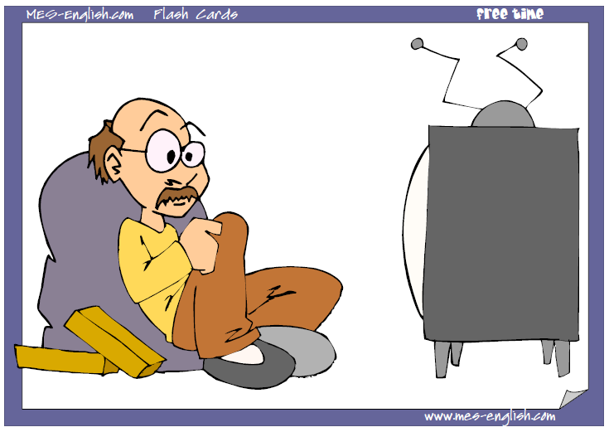
watch a movie

Slide 9
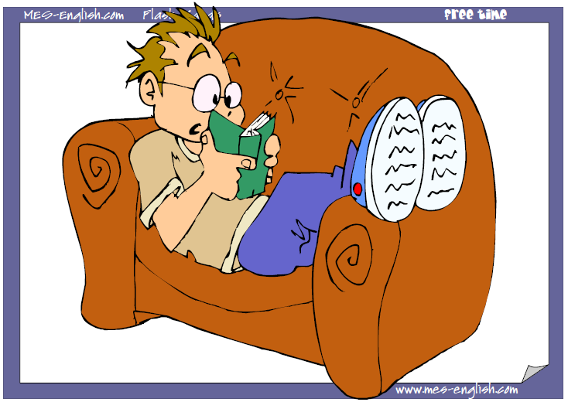
read a book

Slide 10
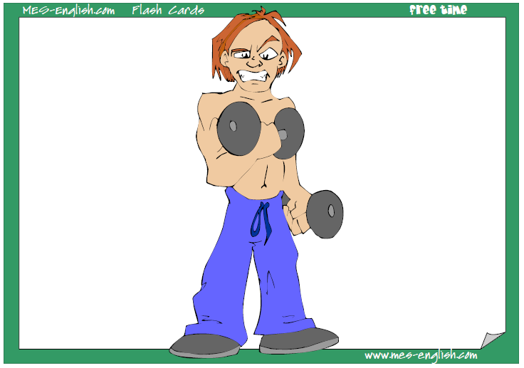
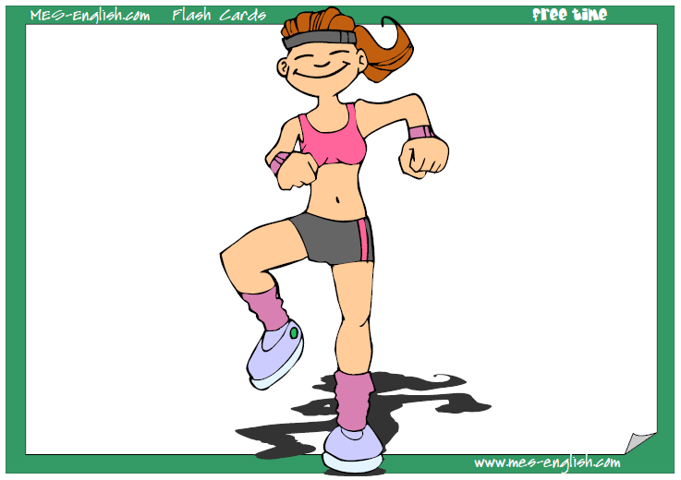
Exercise at the gym

Slide 11
Have a BBQ

Slide 12
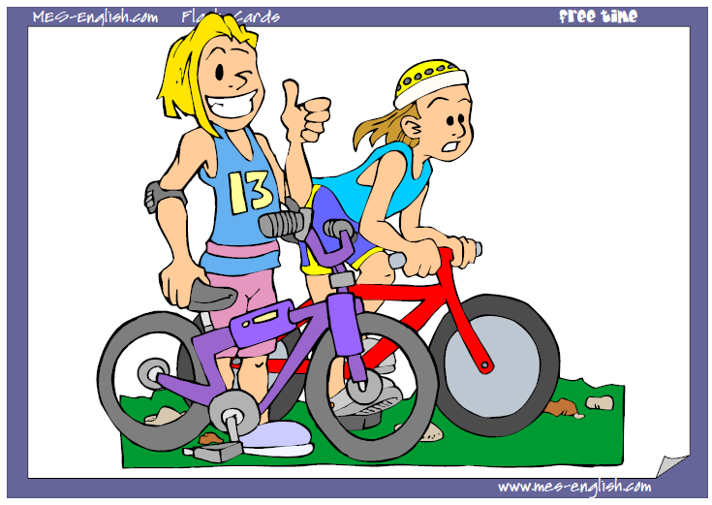
ride a bike - go for a bike ride

Slide 13
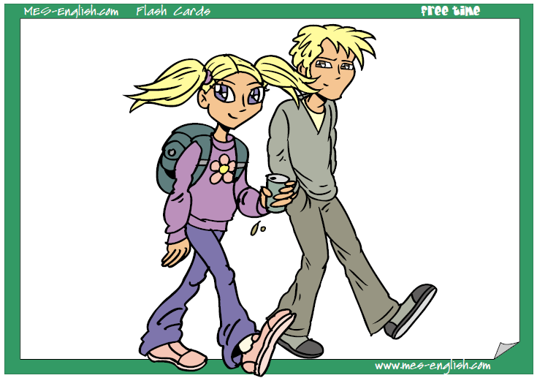
go for a walk

Slide 14
Go on a date

Slide 15
Go out with a friend

Slide 16
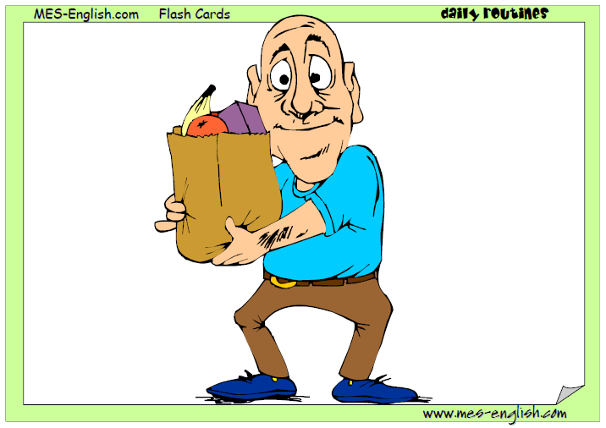
go shopping

Slide 17
Go shopping

Slide 18
Go Bowling

Slide 19
Go Dancing

Slide 20
Spend time with family

Slide 21
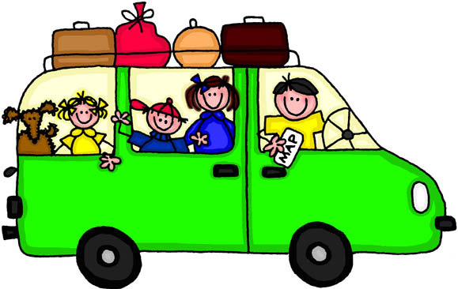
Take a trip somewhere

Slide 22
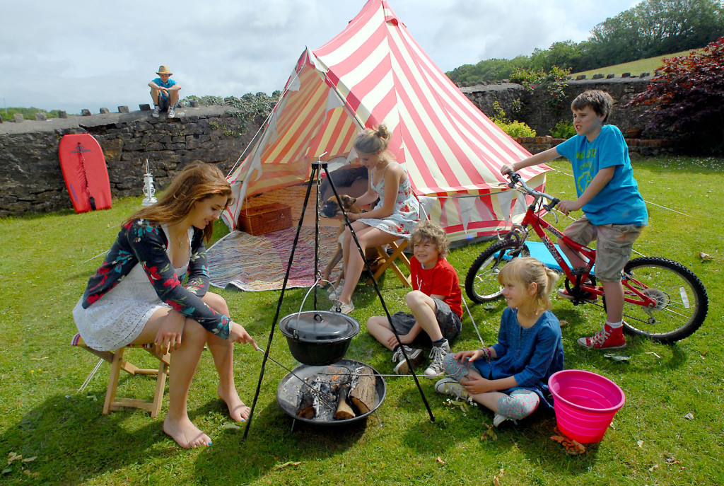
Which things do you do on the weekend?
On Saturdays, I …And on Sundays, I ….

Slide 23
Listening : it´s my day off.
Tomorrow is my day off. I don´t work or go to school.
Class starts at 9:00. Kira comes to class at 8:45. Jenna comes at 9:20. and Anna comes to class at 9:00.
A day off is a free/work day.
Kira / Jenna is early.
Kira / Jenna is late.
Anna / Kira / Jenna is on time.

